Slide 1




รายงานการปฏิบัติสหกิจศึกษา
สำนักงานคณะกรรมการป้องกันและปราบปรามการทุจริตในภาครัฐ
นิสิตสหกิจศึกษา : นาย นนทวัฒน์ นาควังไทร
อาจารย์ที่ปรึกษา : ผศ.สัญญา เครือหงษ์

Slide 2
เกี่ยวกับ
สำนักงานคณะกรรมการป้องกันและปราบปรามการทุจริตในภาครัฐ

Slide 3
งานที่ได้รับมอบหมาย

Slide 4
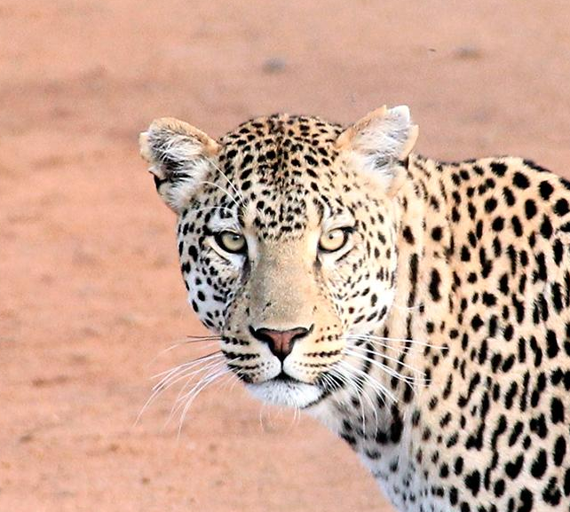
Hello!
I am Jayden Smith
I am here because I love to give presentations.
You can find me at @username

Slide 5
Transition headline
1
Let’s start with the first set of slides

Slide 6
Quotations are commonly printed as a means of inspiration and to invoke philosophical thoughts from the reader.

Slide 7
This is a slide title
Here you have a list of items
And some text
But remember not to overload your slides with content
Your audience will listen to you or read the content, but won’t do both.

Slide 8
BIG concept
Bring the attention of your audience over a key concept using icons or illustrations

Slide 9
You can also split your content
White
Is the color of milk and fresh snow, the color produced by the combination of all the colors of the visible spectrum.
Black
Is the color of coal, ebony, and of outer space. It is the darkest color, the result of the absence of or complete absorption of light.

Slide 10
In two or three columns
Yellow
Is the color of gold, butter and ripe lemons. In the spectrum of visible light, yellow is found between green and orange.
Blue
Is the colour of the clear sky and the deep sea. It is located between violet and green on the optical spectrum.
Red
Is the color of blood, and because of this it has historically been associated with sacrifice, danger and courage.

Slide 11
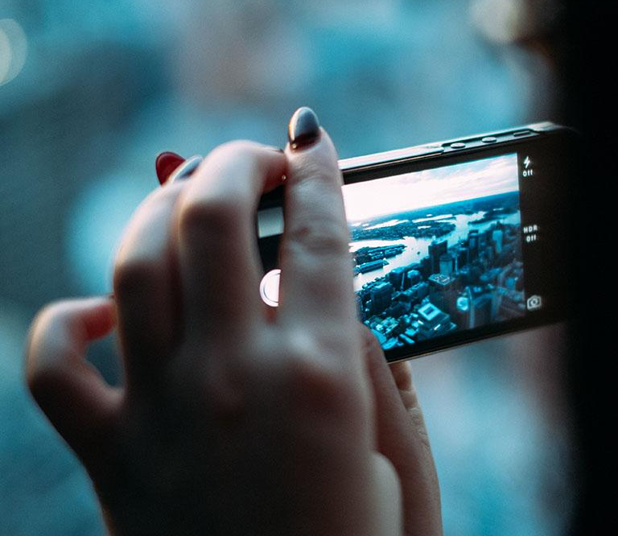
A picture is worth a thousand words
A complex idea can be conveyed with just a single still image, namely making it possible to absorb large amounts of data quickly.

Slide 12
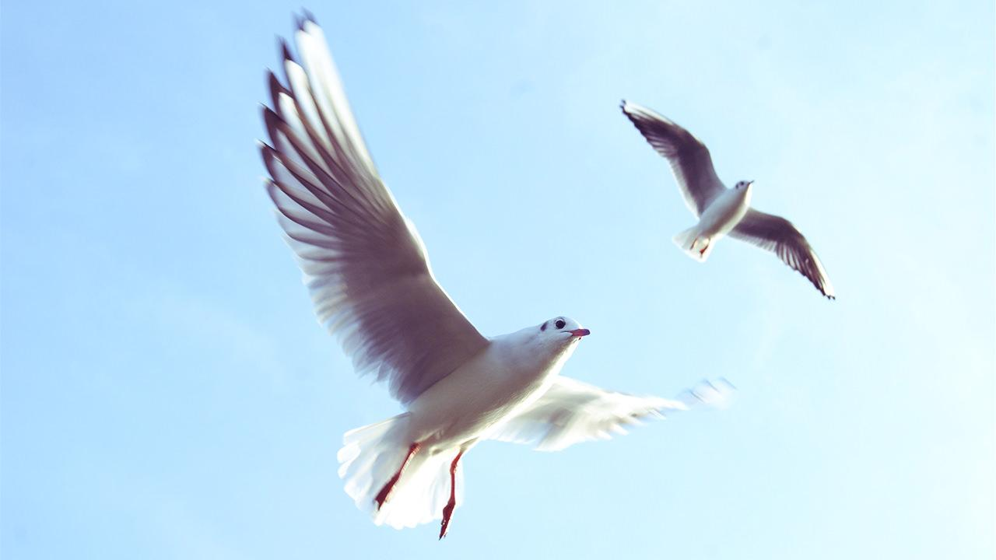
Want big impact?
Use big image.

Slide 13
Use charts to explain your ideas
White
Gray
Black

Slide 14
And tables to compare data
 | A | B | C
Yellow | 10 | 20 | 7
Blue | 30 | 15 | 10
Orange | 5 | 24 | 16

Slide 15
Maps
our office

Slide 16
89,526,124
Whoa! That’s a big number, aren’t you proud?

Slide 17
89,526,124$
185,244 users
100%
That’s a lot of money
And a lot of users
Total success!

Slide 18
Our process is easy
first
second
last

Slide 19
Our sales funnel
20%
40%
60%
80%
Diagram featured by http://slidemodel.com
100%

Slide 20
Let’s review some concepts
Yellow
Is the color of gold, butter and ripe lemons. In the spectrum of visible light, yellow is found between green and orange.
Blue
Is the colour of the clear sky and the deep sea. It is located between violet and green on the optical spectrum.
Red
Is the color of blood, and because of this it has historically been associated with sacrifice, danger and courage.
Yellow
Is the color of gold, butter and ripe lemons. In the spectrum of visible light, yellow is found between green and orange.
Blue
Is the colour of the clear sky and the deep sea. It is located between violet and green on the optical spectrum.
Red
Is the color of blood, and because of this it has historically been associated with sacrifice, danger and courage.

Slide 21
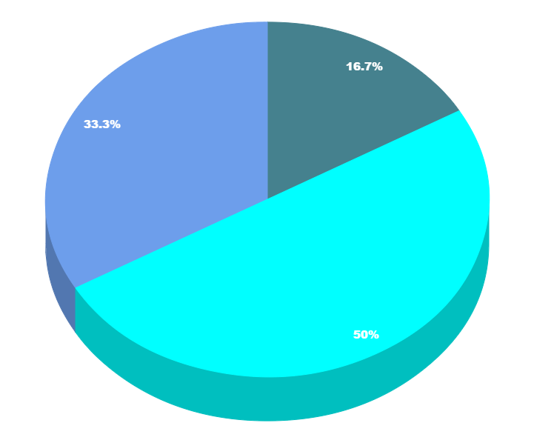
You can copy&paste graphs from Google Sheets

Slide 22
Place your screenshot here
Android project
Show and explain your web, app or software projects using these gadget templates.

Slide 23
Place your screenshot here
iPhone project
Show and explain your web, app or software projects using these gadget templates.

Slide 24
Place your screenshot here
Tablet project
Show and explain your web, app or software projects using these gadget templates.

Slide 25
Place your screenshot here
Desktop project
Show and explain your web, app or software projects using these gadget templates.

Slide 26
Thanks!
Any questions?
You can find me at:
@username
user@mail.me

Slide 27
Credits
Special thanks to all the people who made and released these awesome resources for free:
Presentation template by SlidesCarnival
Photographs by Unsplash

Slide 28
Presentation design
This presentation uses the following typographies and colors:
Titles: Nixie One
Body copy: Muli
You can download the fonts on this page:
https://www.fontsquirrel.com/fonts/nixie-one
https://www.fontsquirrel.com/fonts/muli
Aquamarina #00e1c6 / Turquoise #19bbd5 / Skyblue #2c9dde /
Light gray #c6daec / Dark blue #0e293c
You don’t need to keep this slide in your presentation. It’s only here to serve you as a design guide if you need to create new slides or download the fonts to edit the presentation in PowerPoint®

Slide 29
SlidesCarnival icons are editable shapes.
This means that you can:
Resize them without losing quality.
Change fill color and opacity.
Change line color, width and style.
Isn’t that nice? :)
Examples:

Slide 30
😉
Now you can use any emoji as an icon!
And of course it resizes without losing quality and you can change the color.
How? Follow Google instructions https://twitter.com/googledocs/status/730087240156643328
✋👆👉👍👤👦👧👨👩👪💃🏃💑❤😂😉😋😒😭👶😸🐟🍒🍔💣📌📖🔨🎃🎈🎨🏈🏰🌏🔌🔑 and many more...

